Slide 1
Motivating RD Professionals to ACT by advocating for inclusive language - revising a Seed Grant Program

Slide 2
Goal:
Deliver resources, concepts, and a specific intervention that lowers the activation energy for RD Professionals to recommend and implement equity in seed grant project design
Notes:
Intro (BW)
Presentation of Interventions and MC (SC)
Stand Your Ground (JC)
Questions and Discussion (SC)

Slide 3
Background - Before You Design
Do a baseline analysis - what’s existing?
Identify the goal or goals (be explicit, see “What a Seed Grant Program is good for)
Check in with leadership (lead from the middle)
Know your budget & consider the source
Consider competition platforms

Slide 4
Before You Write the Solicitation
Consider broadly accepted language (attempt to be discipline agnostic) - or allow different disciplines to “choose their own adventure”
Publish review criteria at the time of the call, and design them explicitly for the opportunity avoiding vague criteria (How do I review thee, Falk-Krzesinski & Tobin, 2015)
Develop the review process prior to releasing the solicitation, try to follow published best practices
Ensure that your communications and materials are accessible and make no assumptions about the receiver of communications (e.g., accessibility best practices and plain language)
Review calls for proposals regularly for stereotypes or other biased language (Why Women Don’t Apply for Jobs, Unless They are 100% Qualified, Morh, 2014) that may implicitly discourage applicants from historically underrepresented or marginalized groups
Develop or review program descriptions to consider other potential application/nomination attributes or restrictions that may serve as deterrents to underrepresented group members (e.g., time since PhD requirements that may disproportionately affect women more likely to take time off for family care)

Slide 5
The bare minimum of using inclusive language:
A Choose your own adventure application
Falk-Krzesinski and Tobin, 2015

Slide 6
This application will be reviewed by how clearly the following questions are answered - Why does it matter? (xxx words) How is it new? How will it be done? In what context will it be done? What is special about the people involved? What is the return on investment? How effectively will resources be managed? How will success be determined?
Please select the field that best describes your scholarship:
Biomedical, Engineering, Physical Sciences, Social Sciences, Fine Arts, Humanities, Education
Biomedical
Engineering
Physical Sciences
Social Sciences
Fine Arts
Humanities
Education
Significance
Intellectual Merit
Technical Merit
Relevance
Artistic significance/excellence
Humanities significance/excellence
Importance of the problem
Innovation
Creativity, Originality, Transformative potential
Creativity, Originality, innovative concepts
Novelty, uniqueness, originality
Extent the project deepens and extends the arts’ value
Novelty in idea, approach, method, or use of technology
Responsiveness to the problem
Approach
Rationality of the plan and mechanism to assess success
Technical Approach
Conceptual clarity, feasibility of objectives
Clarity of the project goals and design
Clarity of design and work plan
Quality and clarity of the project design
Environment
Adequate resources to carry out the plan
Feasibility
Adequacy of facilities and project management
Adequacy of facilities
Accessibility of resources
Investigators
Qualifications of the Individual(s)
Management capabilities
Qualifications of project personnel
Quality of the artists
Expertise and level of commitment
Project staff and training
Overall Impact
The potential to benefit society (BI)
The potential to benefit society
Importance to the field
Potential impact on artists, artistic field, community
Likelihood of stimulating or facilitating new research in the humanities
Plan for evaluation
Notes:
Can I build an InfoReady Template that does this?

Slide 7
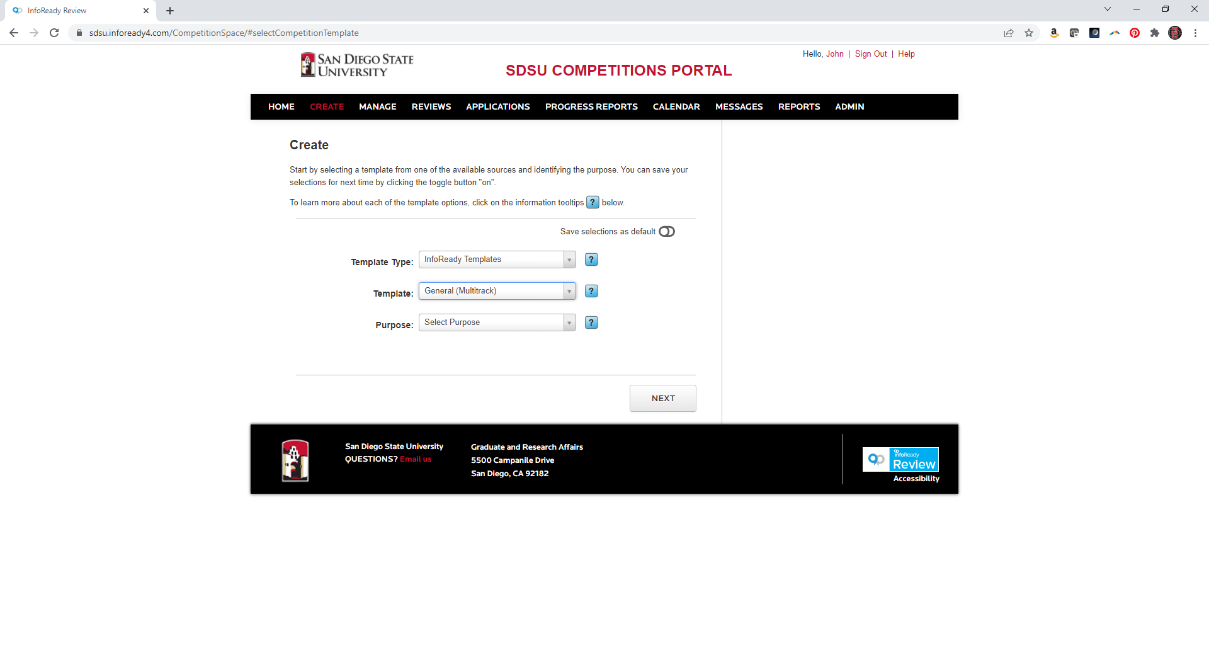

Slide 8
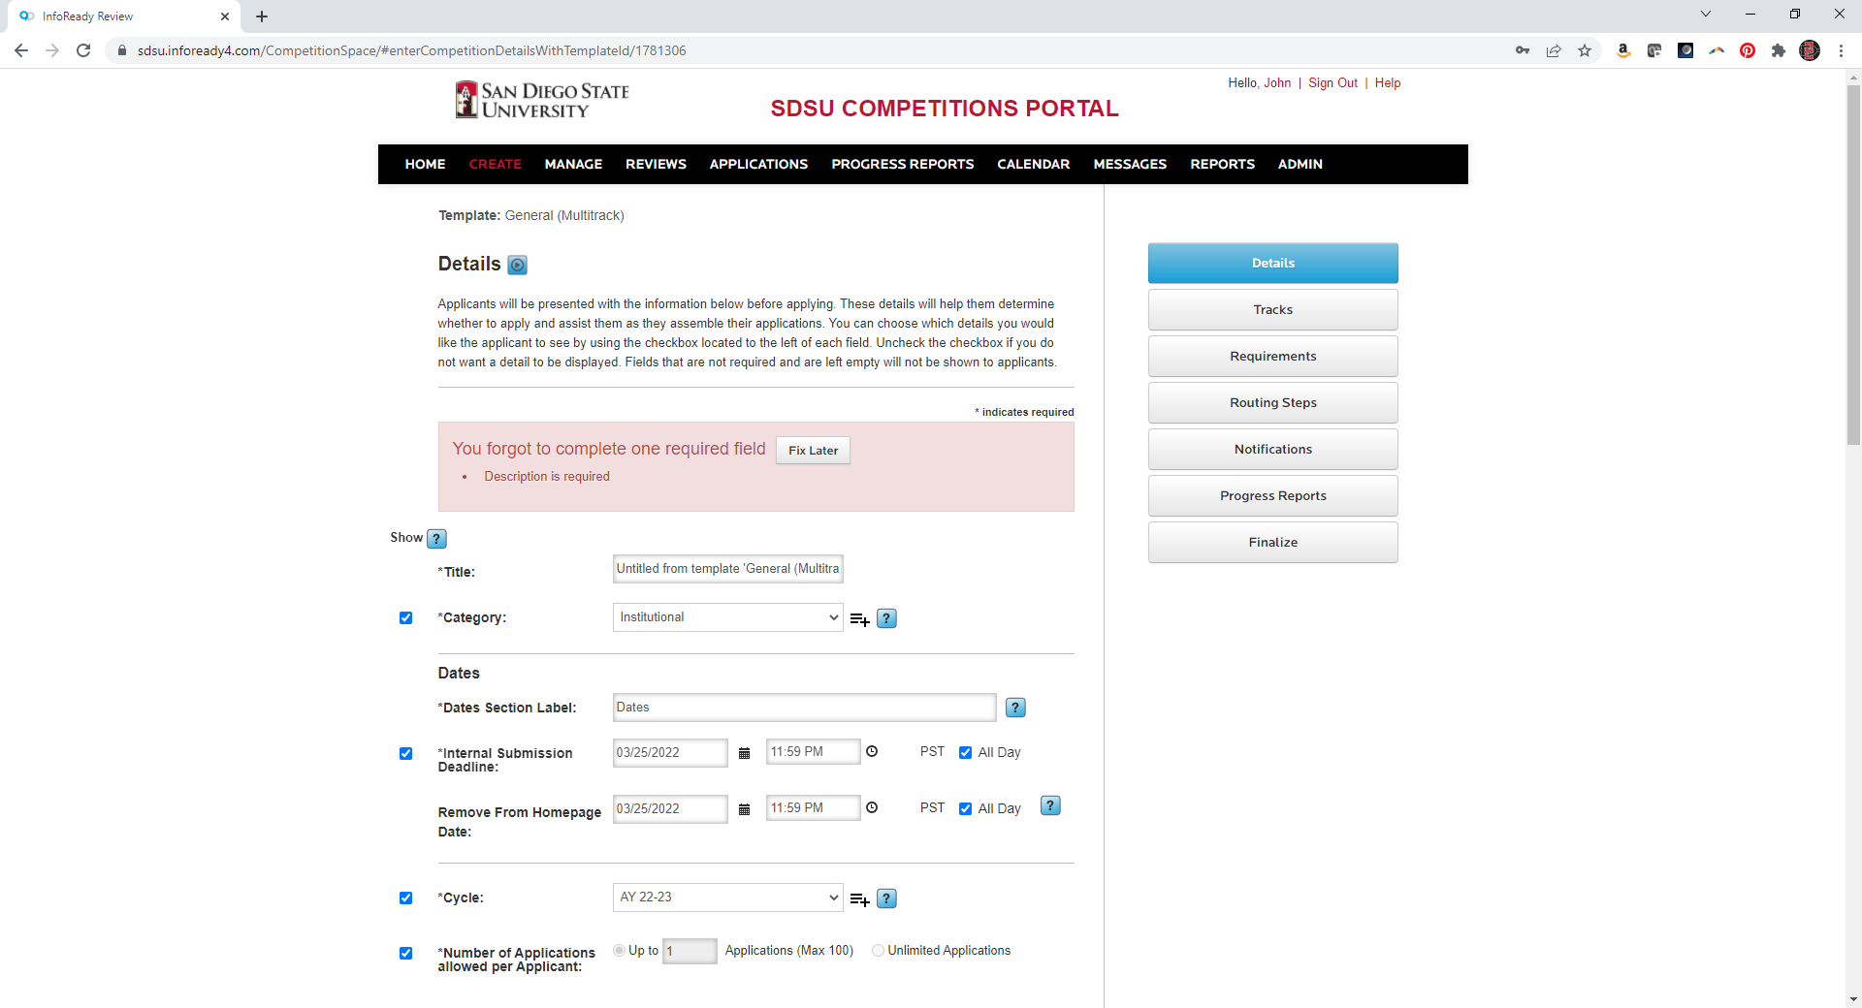
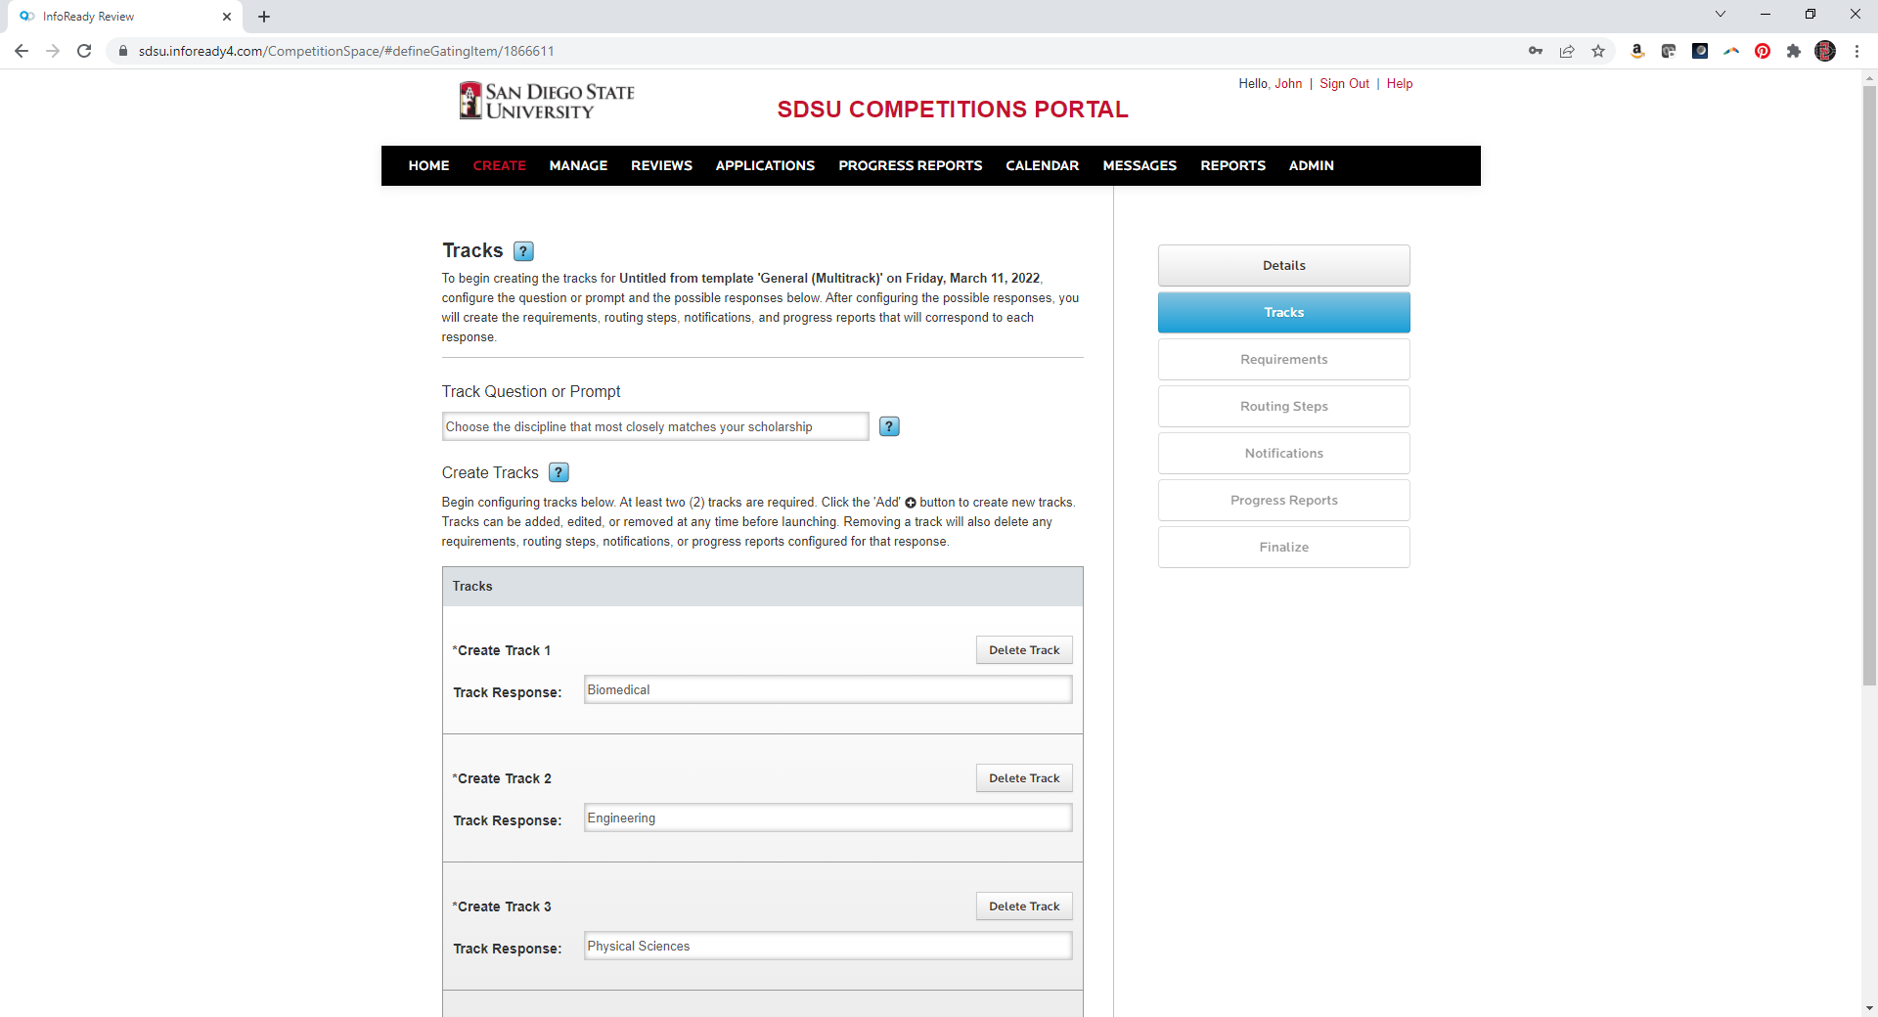
Choose the discipline that most closely matches your scholarship

Slide 9
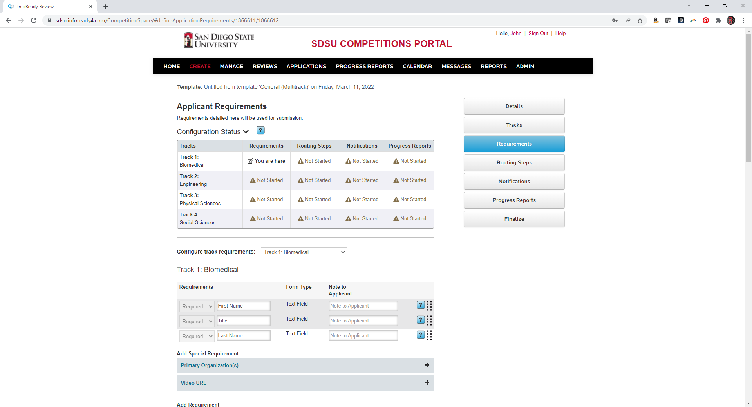

Slide 10
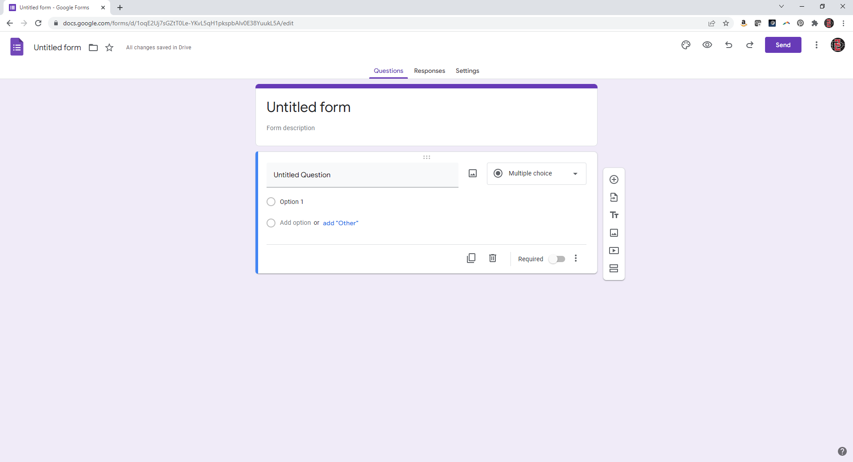

Slide 11
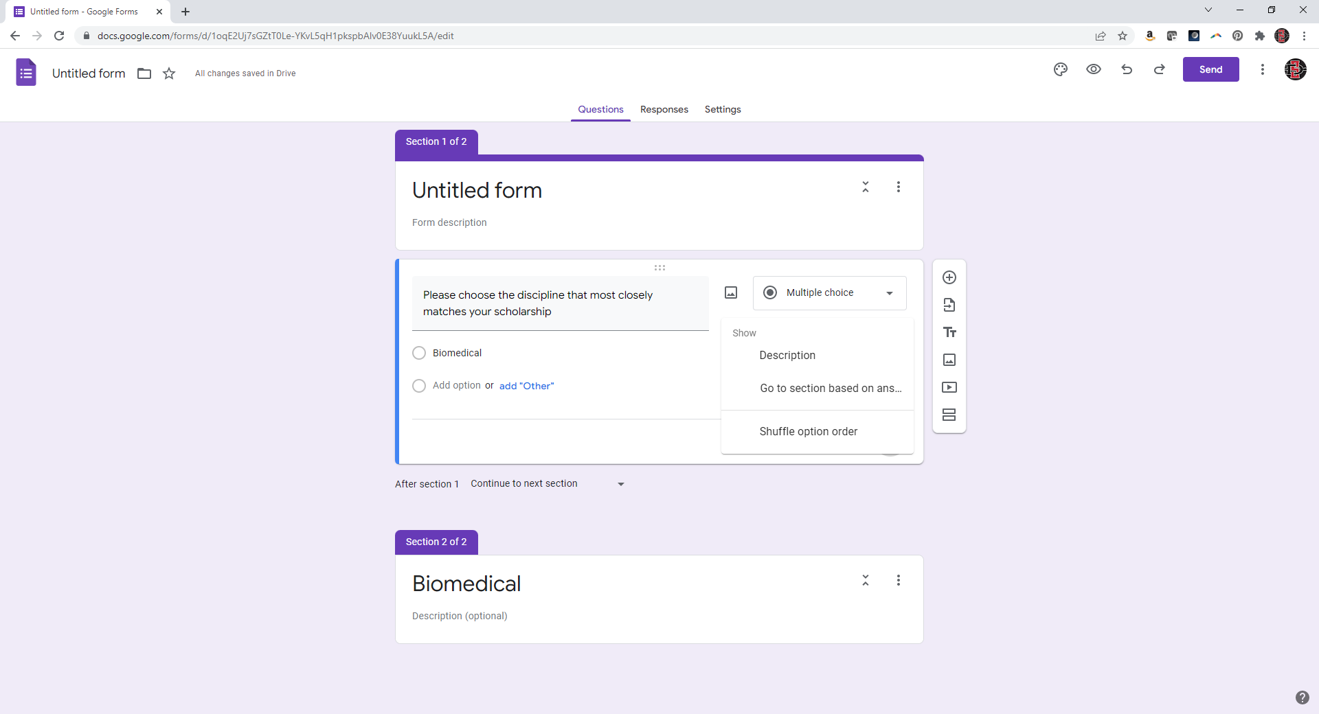

Slide 12
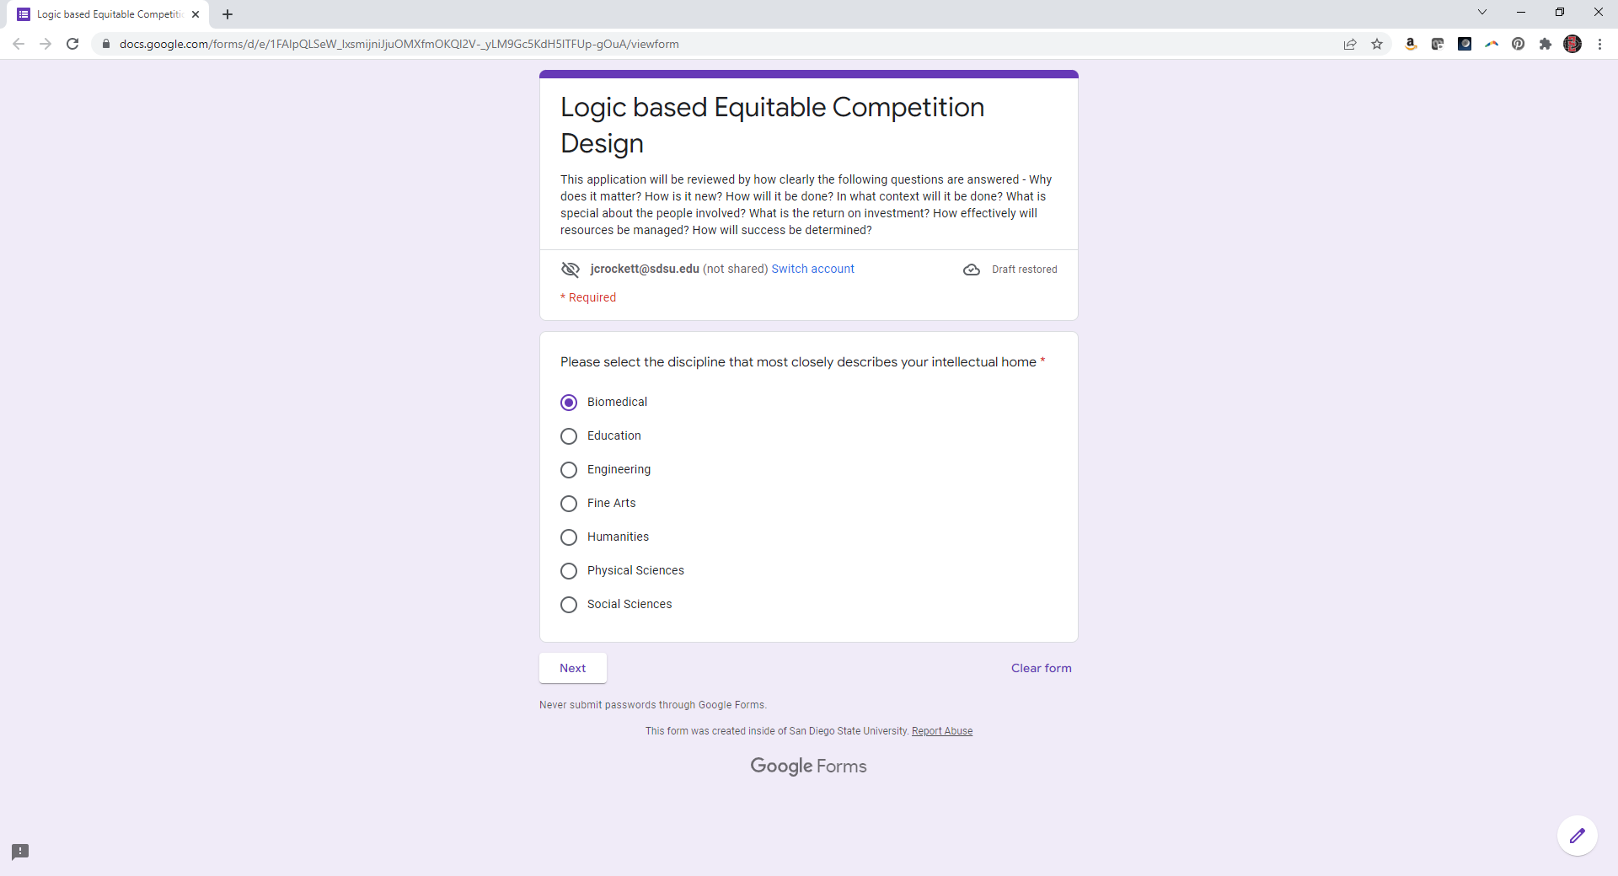
https://forms.gle/VE59GULwN5GAbEk68

