Slide 1
Strategies for Equitable Selection

Slide 2
Motivation and Rationale:
Academic structures, peer-review processes are biased, exclusionary
Scholars belonging to historically underrepresented groups and/or those who work in non-STEM disciplines are comparatively and competitively disadvantaged
Holistic, systems approaches can help enable transparent, equitable, and inclusive selection of internal funding recipients
Noticing, naming, and nurturing such approaches can disrupt entrenched processes and systems, helping funding programs be more inclusive and effective
Notes:
Intro (BW)
Presentation of Interventions and MC (SC)
Stand Your Ground (JC)
Questions and Discussion (SC)

Slide 3
Broad Approaches
Begin with the end in mind: articulate a goal and motivating values
How can we create transparent, equitable, and inclusive selection processes?
Break the selection system into component parts
Consider disruptions, innovations within and/or across the parts
Recruiting reviewers
Onboarding and calibrating reviewers
Designing and implementing review processes
Design a plan, solicit feedback
Refine the plan – then implement it
Commit to continuous improvement

Slide 4
Opportunities
Recruiting reviewers
Leverage intentional, inclusive messaging
Indicate – explicitly – whom you are calling on and welcoming in
“The perspectives of scholars who belong to historically underrepresented groups, including gender and racial/ethnic minorities and individuals having other minoritized identities, are highly valued and sought as part of the proposal review process. Faculty from all academic ranks — including those earlier in their career — are encouraged to volunteer.”
https://research.unl.edu/blog/grand-challenges-proposal-reviewers-needed/
Articulate benefits of service
Issue a call to action
Leverage a trusted spokesperson and follow up using torchbearers
https://www.youtube.com/watch?v=d5kQrJdCZ6E

Slide 5
Opportunities
Onboarding and calibrating reviewers
Require structured, intentional pre-review training
Funding opportunity purpose
Reviewer roles
Anti-bias training
Conflict of interest
Review flow
Use of a well-defined reviewer rubric
Host mock review panel(s)

Slide 6
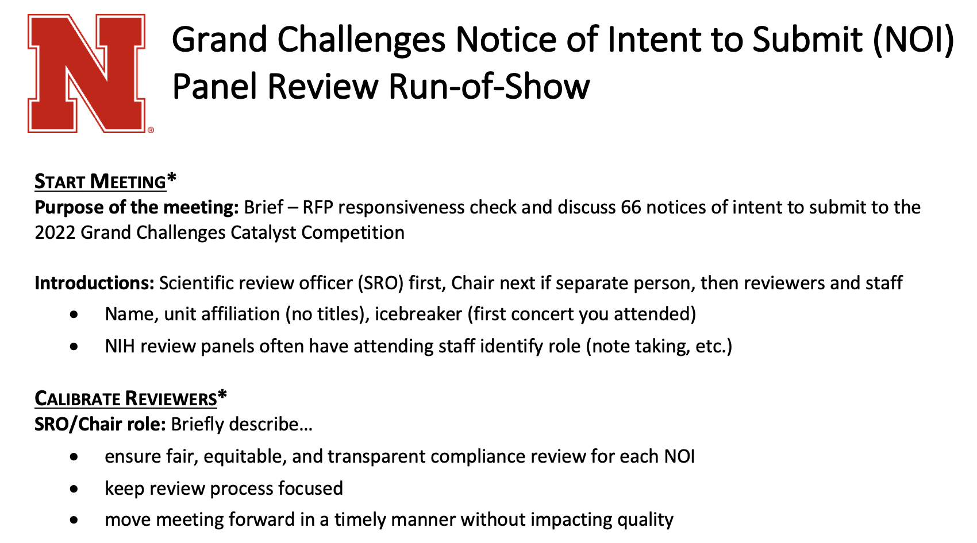
Opportunities
Designing and implementing review processes
Design scoring rubrics, review criteria with campus community input
Develop and stick to a panel review run-of-show

