Slide 1
Identity and Identification
Leveraging Diversity by
Creating Inclusive Teams

Slide 2
These materials were developed by the Center for Research, Excellence, and Diversity in Team Scholarship (CREDITS) - https://credits.ucsb.edu
NSF ADVANCE Funding, 2015-2022
https://new.nsf.gov/funding/opportunities/advance-organizational-change-gender-equity-stem
Co-Investigators:
Barbara Endemaño Walker, University of California Santa Barbara
Susan Carlson, University of California Office of the President (emerita)
Susan Carter, Santa Fe Institute
John Crockett, San Diego State University
Valerie Leppert, University of California Merced
Rebecca Lewison, San Diego State University
Amanda Quintero, California State University Northridge
Suggested Attribution: CREDITS Inclusive Collaboration Toolkit by Center for Research, Excellence, and Diversity in Team Science (CREDITS) is licensed under a Creative Commons Attribution-NonCommercial 4.0 International License.

Slide 3
Individual identities can be diverse Identification with a TEAM has many benefits

Slide 4
Overview
Concepts defined
Evidence for benefits of diversity and inclusion in teams
Tools for detecting, mitigating, and strengthening inclusion on teams

Slide 5
Concepts Defined

Slide 6
Definitions
Identity: your concept of self is based on group membership (Tajfel & Turner, 1979)
Similar to social category (race, gender, age, sexual orientation, religion, age …)
Tied to self-concept / Who am I?
Threats to identity produce defensiveness, withdrawal, diminishment of self
Identification: a perception of oneness with a group of persons (Ashforth & Mael, 1989)
“I am a Banana Slug” (Identification with an institution)
“I am a chemical engineer” (Identification with a profession)
“I am in the Ortega Lab” (Identification with a professional group)
Identification is a powerful motivator!
Notes:
FIND BETTER DEFINITIONS that are easier to explain / present … ID is self-concept, Identification is the process through which own self-concept comes to overlap with a particular group.

Slide 7
Collaboration is Increasingly the Norm
over 90% of publications were authored by two or more individuals in 2013
(National Research Council, 2015)

Slide 8
Teams Science Basics
Necessary to solve intractable complex problems.
Garners more funding
Yields greater publication productivity
Yield higher impact publications
Uzzi et al. 2013
Stokols et al. 2008
Falk-Krzesinski et al. 2011
Elfner et al. 2011
Hall et al. 2012
Salazar et al. 2012

Slide 9
Evidence for Benefits of Diversity and Inclusion in Teams

Slide 10
Bibliometric Evidence – Gender in Co-Authorship Teams
Campbell, L. G., Mehtani, S., Dozier, M. E., & Rinehart, J. (2013). Gender-heterogeneous working groups produce higher quality science. PloS one, 8(10), e79147.
Among ecology and environmental scientists, authorship teams with at least one woman received 34% more citations than publications produced by homogeneous teams, and that peers perceive the publications produced by gender-diverse groups to be of higher quality.

Slide 11
Bibliometric Evidence – Ethnic Diversity in Co-Authorship Teams
Freeman, R. B., & Huang, W. (2015). Collaborating with people like me: Ethnic coauthorship within the United States. Journal of Labor Economics, 33(S1), S289-S318.
By examining the ethnic identity of authors in over 2.5 million scientific papers written by US-based authors from 1985 to 2008, we find that persons of similar ethnicity coauthor together more frequently than predicted by their proportion among authors. The greater homophily is associated with publication in lower-impact journals and with fewer citations.

Slide 12
Gender Diversity and Social Sensitivity
“Collective intelligence” appears to be correlated with the
average social sensitivity of group members
the equality in distribution of conversational turn-taking
the proportion of females in the group
It is not strongly correlated with the average or maximum individual intelligence of group members (Woolley et al., 2010).

Slide 13
Diverse Teams in Organizations
Positive effects on creativity, innovation, and productivity
Hong & Page 2004

Slide 14
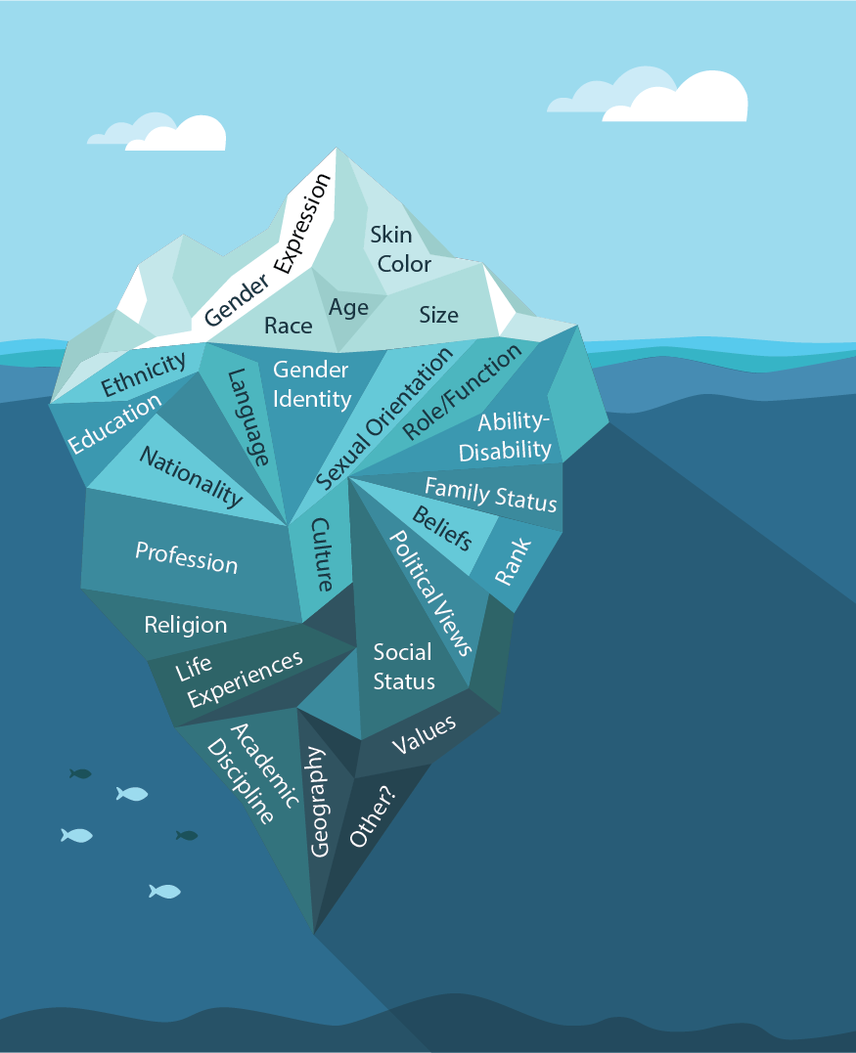
Other Diverse Identities to Consider
Expect Intersectional Diversity in Your Team
Differences are Visible and Invisible
(Handout 1: Diverse Identities)

Slide 15
Definitions
Intersectionality:
the interconnected nature of social categorizations such as race, class, and gender as they apply to a given individual or group, creating overlapping and interdependent systems of discrimination or disadvantage
a framework to analyze how systems of power, oppression, and privilege impact individuals’ lived experiences based on their various social-group identities (Crenshaw, 1991; Collins, 1990 )
Can result in an “accumulation of disadvantage” wherein multiple small biases in the same direction are compounded to have a large effect (Valian, 1998)

Slide 16
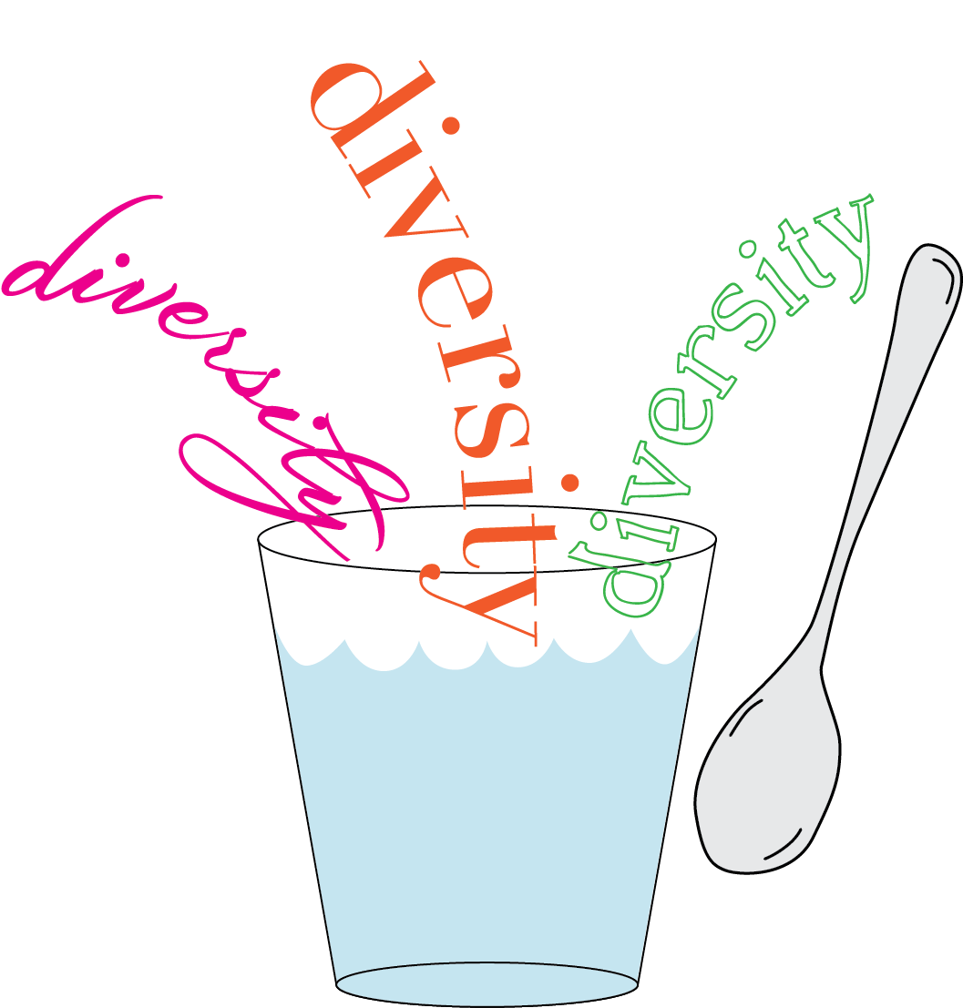
It is not enough to add diversity and stir… INCLUSION is also necessary

Slide 17
Definitions
Inclusion: Ensuring that people feel a sense of belonging in the workplace. This means that every employee feels comfortable and supported by the organization when it comes to being their authentic selves.
Equity: Ensuring that practices and programs are impartial, fair, and provide equal possible outcomes for every individual, according to varied disadvantages and privilege.

Slide 18
Inclusive Leadership
Including others in discussions and decisions in which their voices and perspectives might otherwise be absent
(Edmondson, Kramer, & Cook, 2004; Nembhard & Edmondson, 2006)
Avoid self-serving leadership: putting your own interests above both your team members’ needs and the goals of the organization
(Peng, Wang, & Chen, 2019; Camps, Decoster, & Stouten, 2012).

Slide 19
Equitable Work Environments and Inclusive Organizational Policies
“Under conditions of equitable and integrated work environments, diversity leads to creativity, innovation, productivity... Thus, effective policies for diversity in science and engineering must also address integration in the organizational contexts in which diverse teams are embedded”
(Smith-Doerr, Alegria, & Sacco, 2017).

Slide 20
Engagement-Focused Diversity Climate
In a study of 48 teams, researchers founds that effective diverse teams were more prevalent in organizations that had an engagement-focused diversity climate characterized by
utilization of diversity to inform and enhance work processes based on the
assumption that cultural differences give rise to different knowledge, insights, and alternative views
(Hajro, Gibson, & Pudelko, 2017)

Slide 21
Tools for Assessing and Strengthening Inclusion on Teams

Slide 22
Using the Tools
Problems to Solve:
Individual identities <> Team Identification
Individuals feel they don’t belong / aren’t welcome
Individuals believe that their contributions will not be valued / recognized
Individuals fail to disclose / share information or knowledge, lower motivation, lower well-being
Measure:
Individual identities (identity wheel)
Perceived overlap of individual and TEAM identity (circles)
The “Fix”
Build a TEAM IDENTITY that can serve as a superordinate identity
Build TEAM TRUST (willingness to be vulnerable in team) through Psychological Safety

Slide 23
Overview of Team Tools & Measures
Team Formation
1. Who Do You Most Trust?
Proposal Development & Writing
2. Identity Wheel
Active Research Teams
3. Psychological Safety
4. Identification with Team

Slide 24
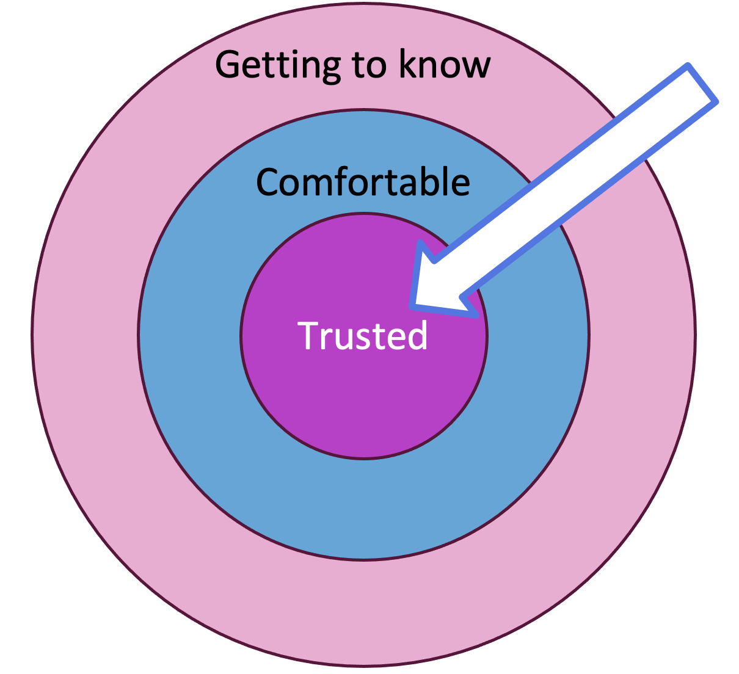
Team Formation
Team Formation
Who Do You Most Trust?
Tool 1: Who Do You Most Trust?
A tool for RD/RA facilitators and team leaders to conduct with new and nascent teams to begin understanding patterns of team formation.

Slide 25
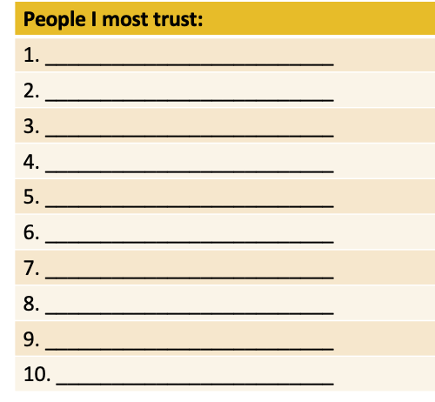
TOOL 1: Who do you Most Trust?
Take a piece of paper or open a blank spreadsheet
In a column: List names/initials of people who you most trust (not relatives)

Slide 26
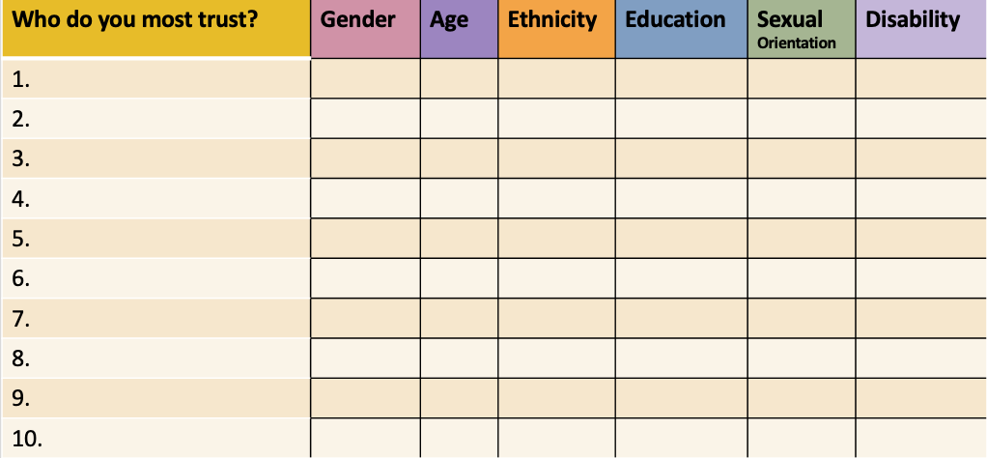
Now, fill in other columns …

Slide 27
Who do you most trust?
It is likely that the people you most trust have more shared identities with you.
Getting to know
Comfortable
Trusted
Consider how this may affect innovation on your team.

Slide 28
MESSAGE:
People tend to trust people who seem similar to them
Can lead to homogeneous, not diverse, teams

Slide 29
Proposal Development & Writing
Tool 2: Identity Wheel
A tool for RD/RA facilitators and team leaders to facilitate with team members
Ask team members to use individually to explore how their identities may intersect with their professional life, and which identities are important for them to be “seen” on the team.
Results do not have to be shared. This can be a self-reflection tool.

Slide 30
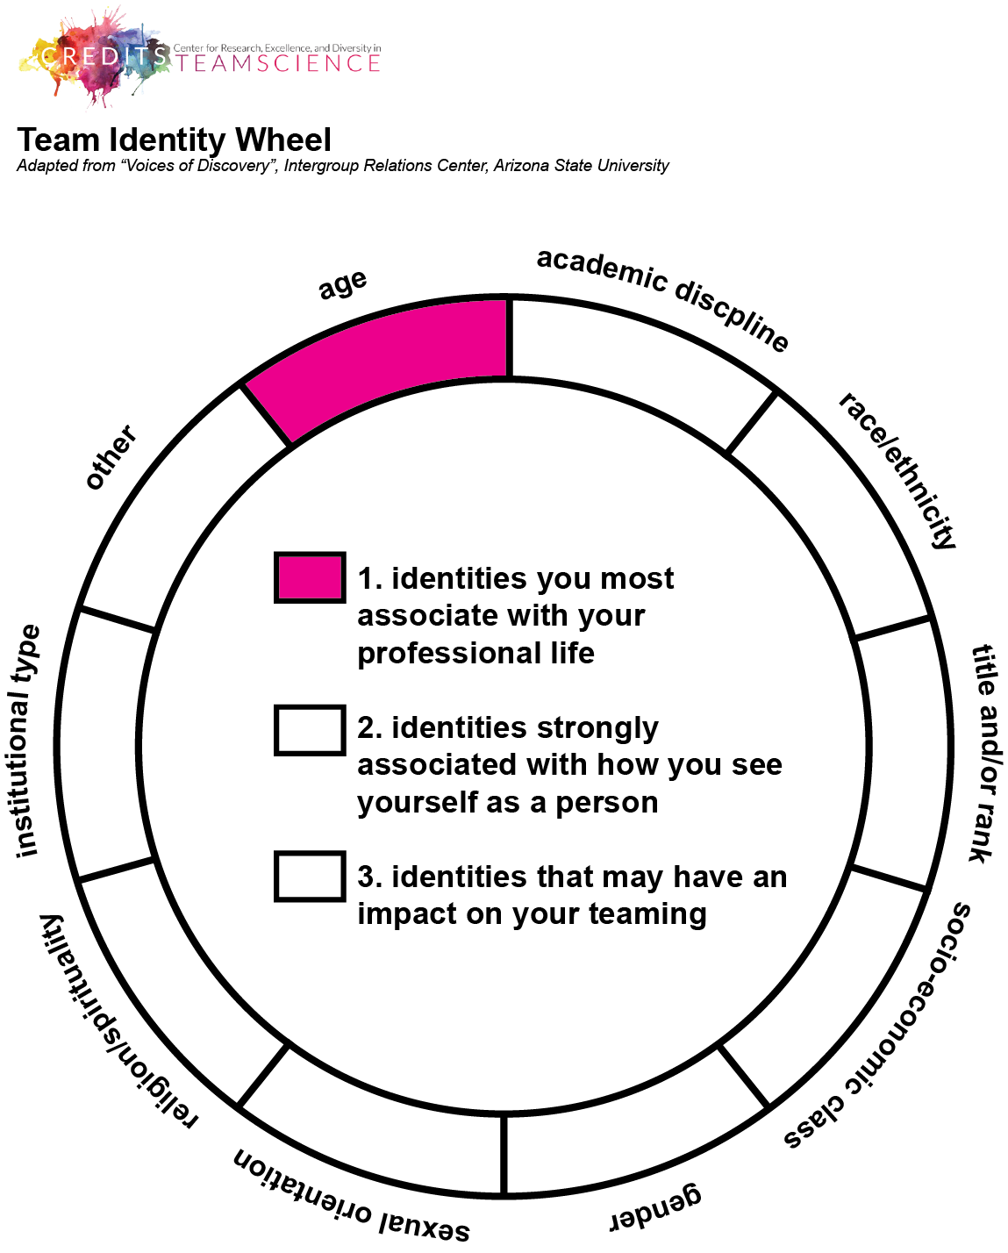
Tool 2: Identity Wheel
Proposal Development & Writing
Identity Wheel
(Handout 2: Identity Wheel)

Slide 31
MESSAGE:
Individual team members should be recognized for the contributions and expertise they bring to the team.
Team leaders should be welcoming of diverse identities among team members. Leaders don’t need to know the identities, but they should expect and welcome diversity (Hajro, Gibson, & Pudelko, 2017).
Leaders and team members should use “words and deeds … that invite and appreciate others’ contributions” related to their disciplinary and other identities that would add to the creativity and innovation of the team (Nembhard & Edmondson, 2006)

Slide 32
Active Research Teams
Active Research Teams
Psychological Safety
Identification with Team
Tool 3: Psychological Safety
A tool for team leaders to conduct with team members anonymously to check in with team functioning and how inclusive the environment is.
Tool 4: Team Identification Tool
A tool for team leaders to conduct with team members anonymously to check in with team identification.

Slide 33
Tool 3. Psychological Safety Definitions
“the shared belief held by members of a team that the team is safe for interpersonal risk-taking, and that members can challenge, question and disagree without suffering consequences to their image, reputation or career. ” (Dekker & Edmondson, 2022).
“a condition in which one feels (a) included, (b) safe to learn, (c) safe to contribute, and (d) safe to challenge the status quo, without fear of being embarrassed, marginalized or punished in some way” (Clark, 2019).

Slide 34
Tool 3. Psychological Safety Anonymous Team Survey
How strongly do you agree or disagree with these statements:
If you make a mistake on this team, it is often held against you.
Members of this team are able to bring up problems and tough issues.
People on this team sometimes reject others for being different.
It is safe to take a risk on this team.
It is difficult to ask other members of this team for help.
No one on this team would deliberately act in a way that undermines my efforts.
Working with members of this team, my unique skills and talents are valued and utilized.
(Handout 3: Psychological Safety Survey)

Slide 35
MESSAGE
QUOTES LINKING PSYCH SAFETY TO TEAM COHESION AND CREATIVITY

Slide 36
Tool 4: Identification with Team
Definition: “the process by which individual team members perceive themselves in terms of the values, goals, attitudes, and behaviors they share with other team members (Janssen & Huang, 2008).
When teams share group norms that appreciate the value of individuality and diversity, expressions of individual differences may reinforce rather than conflict with team identification (Swann et al., 2003).
“Leaders can instigate [a] sense of inclusion in their team by engaging in two behaviors:
stimulating all members of the team to fully express their unique viewpoints and perspectives (harvesting the benefits of diversity) and
facilitating beliefs about the value of differences in the team (cultivating value-in-diversity beliefs) (LeRoy et al., 2022).

Slide 37
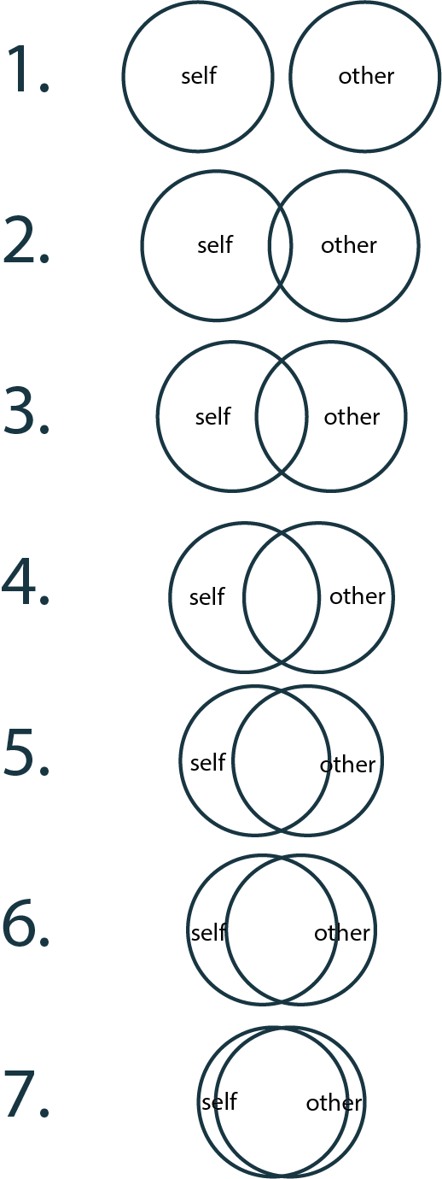
Tool 4: Identification with Team Anonymous Team Exercise
To what extent do you perceive overlap with your own identity and the TEAM?
Measure of perceived overlap of self and team (adapted from Aron’s Inclusion of Other in the Self (IOS) Scale (1992).
(Handout 4: Team Identification)

Slide 38
MESSAGE:
Strong identification is related to:
Cohesion
Loyalty
Retention
Trust
Cooperation
Personal goals < Team goals
When identification is weak: hard to establish team-based trust or confidence in fellow members

Slide 39
IN PRACTICE: Foster team identification
“We are the IN group” – foster camaraderie
Team meetings, social gatherings, pep rallies
Team artifacts: “branding” – shirts, hats, mugs, signs
Reinforce unique team identity
“Us versus Them” – create a common enemy
Another team (who else does research in your area?)
A societal problem

